Slide 1

“ Don’t neglect your mother tongue. Become Bilingual. “
Pitch by Soh Kai Meng Leonard (P2006264) of DISM/1B/05

Slide 2
“Don’t neglect your mother tongue. Become Bilingual.” CA2 Pitch
Purpose
Audience
Context
To persuade you all
to not neglect your mother tongue
To encourage you all to become bilingual
My fellow classmates from SP, from all diploma courses and years
A pitch held in lecture theatre 8 at block 19 as a series of talks for “Preserving cultural heritage in Singapore” by School of Communication, Arts & Social Science

Slide 3
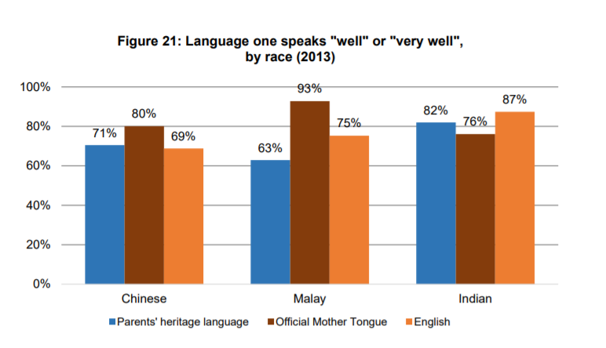
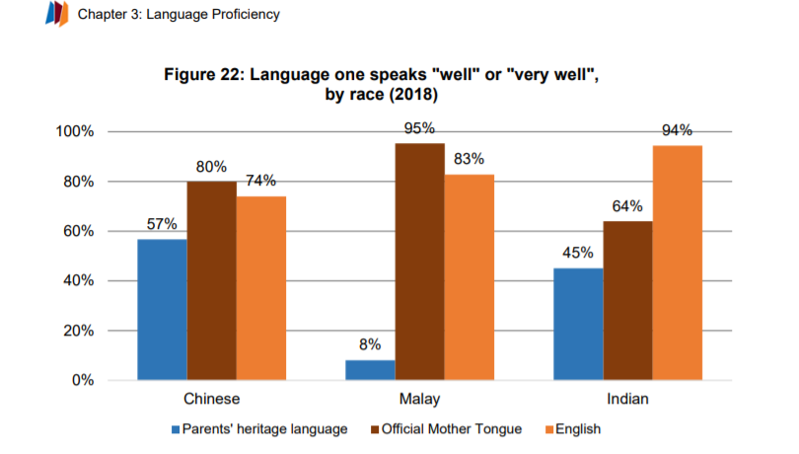
Introduction
Diagram by (Mathews , et al., 2020)

Slide 4



My Narrative and the Reason why not to neglect mother tongue
为什么你是华人, 但不可以讲华语
Notes:
Trigger event
https://www.google.com/url?sa=i&url=https%3A%2F%2Fsciencenordic.com%2Fchildren-and-adolescents-denmark-learning%2Fschools-to-blame-for-unmotivated-students%2F1421116&psig=AOvVaw1A7yjwkm_sapLbiT6YkvYh&ust=1643983414631000&source=images&cd=vfe&ved=0CAsQjRxqFwoTCKC1tsPa4_UCFQAAAAAdAAAAABAD
https://www.google.com/url?sa=i&url=https%3A%2F%2Fwww.nea.org%2Fadvocating-for-change%2Fnew-from-nea%2Ffive-educators-share-advice-new-teachers&psig=AOvVaw1xzrslinRW14NDsHsyZLY7&ust=1643983798531000&source=images&cd=vfe&ved=0CAsQjRxqFwoTCOjz9Ibb4_UCFQAAAAAdAAAAABAD

Slide 5
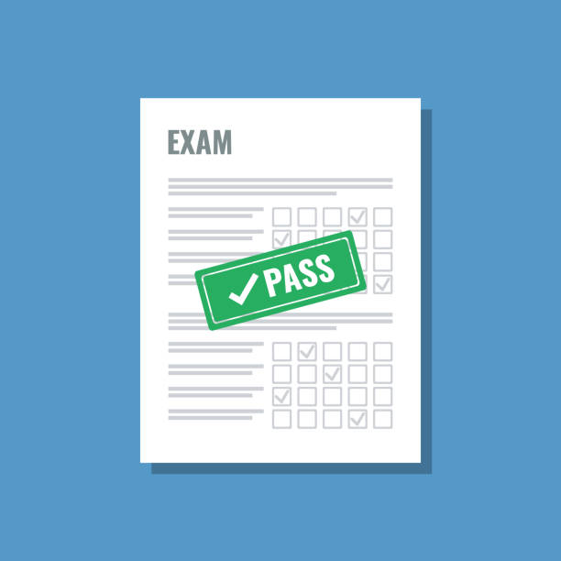

My Narrative and the Reason why not to neglect mother tongue
Notes:
Transformation
https://www.google.com/url?sa=i&url=https%3A%2F%2Fwww.istockphoto.com%2Fphotos%2Fpassing-exam&psig=AOvVaw1rWr_Xy4k8VKuRW5NvHRLW&ust=1643983851030000&source=images&cd=vfe&ved=0CAsQjRxqFwoTCNiPxabb4_UCFQAAAAAdAAAAABAD
https://www.google.com/url?sa=i&url=https%3A%2F%2Fproductfolio.com%2Fboulders-stones-and-pebbles%2F&psig=AOvVaw09_LcmpT9alcm_GCKXKLrZ&ust=1643984256559000&source=images&cd=vfe&ved=0CAsQjRxqFwoTCJCpq-Dd4_UCFQAAAAAdAAAAABAD

Slide 6


My Narrative and the Reason why not to neglect mother tongue
Notes:
Life Lesson / Message
https://www.google.com/url?sa=i&url=https%3A%2F%2Fonepercentbetter.com%2Fhuman-connection-meaningful-tips%2F&psig=AOvVaw3k21pneCsEnP1ntHw039_S&ust=1643984589074000&source=images&cd=vfe&ved=0CAsQjRxqFwoTCMi-3Y_g4_UCFQAAAAAdAAAAABAD
https://www.google.com/url?sa=i&url=https%3A%2F%2Fmedium.com%2Fdistributed-economy%2Fthe-art-of-conversation-the-sharing-of-thoughts-and-exploration-of-ideas-c2873592a942&psig=AOvVaw2rKdYq7RckU0UCNi-RN4sQ&ust=1643985228308000&source=images&cd=vfe&ved=0CAsQjRxqFwoTCMCVxbPg4_UCFQAAAAAdAAAAABAK

Slide 7





My Narrative and the Reason to become bilingual
Notes:
How will the audience benefit from the story?
+
Call to Action
https://www.google.com/url?sa=i&url=https%3A%2F%2Fallen-faulton.medium.com%2Fthe-modern-survival-guide-29-the-impact-of-social-bonds-5bac4a64942e&psig=AOvVaw2kcba4xhOUK8nUqnqubB-L&ust=1643986088191000&source=images&cd=vfe&ved=0CAsQjRxqFwoTCLDhhcrj4_UCFQAAAAAdAAAAABAD

Slide 8
“The limits of my language mean the limits of my world”
By Ludwig Wittgenstein
Thank You

Slide 9
Q & A

Slide 10
References
British Study Centres , 2015. Inspirational Quotes for Language Learners. [Online] Available at: https://www.british-study.com/en/blog/inspirational-quotes-for-language-learners [Accessed 2 2 2022].
Mathews , M., Tay, M., Shanthini, S. & Tan, Z. H., 2020. Language Proficiency, Identity & Management - Lee Kuan Yew School of Public Policy. [Online] Available at: https://lkyspp.nus.edu.sg/docs/default-source/ips/ips-exchange-series-15.pdf [Accessed 2 2 2022].
MOE, 2021. Learning a Mother Tongue Language in primary school. [Online] Available at: https://www.moe.gov.sg/primary/curriculum/mother-tongue-languages/learning-in-school [Accessed 2 2 2022].
Yong, J., 2019. In English-speaking Singapore, children face huge challenges in mastering mother tongue. [Online] Available at: https://www.channelnewsasia.com/commentary/mother-tongue-language-bilingual-education-parenting-learning-1313646 [Accessed 2 2 2022].

